Slide 1
Logistics Microservice for the Soaring through the Clouds – The Sequel
EMEA PaaS Partner Forum
Budapest, March 2018

Slide 2
The Shop and its Departments (microservices)
Shop
Lucas
Guido
Luis
Lonneke
Jose
Product Catalog
including
Pricing & Discounts
Order
Customers
Loyalty Program
Lucas
Sven
Logistics (Warehouse, Stock, Shipping)
Billing, Invoicing & Collection

Slide 3
Logistics Microservice
Shipping Operations
Submit Shipping
=> orderIdentifier, destination, desired ETA, items
<= shippingIdentifier, ETA, shippingCosts
ValidateProposedShipment
=> items, destination <= Validation result
Cancel Shipping (=> shippingIdentifier)
Request Status (=> shippingIdentifier)
Retrieve Details (=> shippingIdentifier)
FindShippings (=> search criteria)
Stock Operations
Check Stock for Product (=> productIdentifier)
Replenish Product Stock (=> productIdentifier, quantity)
Checkout Stock (=> productIdentifier, quantity, purpose, orderIdentifier)
FindStockPositions (=> search criteria)
API
API
Product Update (incl new product)
Order Cancelled
Product Out Stock
Product In Stock
Shipping News
Country Shipping Rules
Shipping
Parcel
Stock Item
Items
ShipLog
Stock Item Log
Submit Parcel
=> shippingIdentifier, location, desired ETA, items
<= track & trace, ETA
Parcel Status Update
* shippingIdentifier
* location, ETA, status
Logistics Management User Interface
Manage Shippings
Manage Stock
Shipping Partners
(DHL, FedEx, UPS,…)

Slide 4

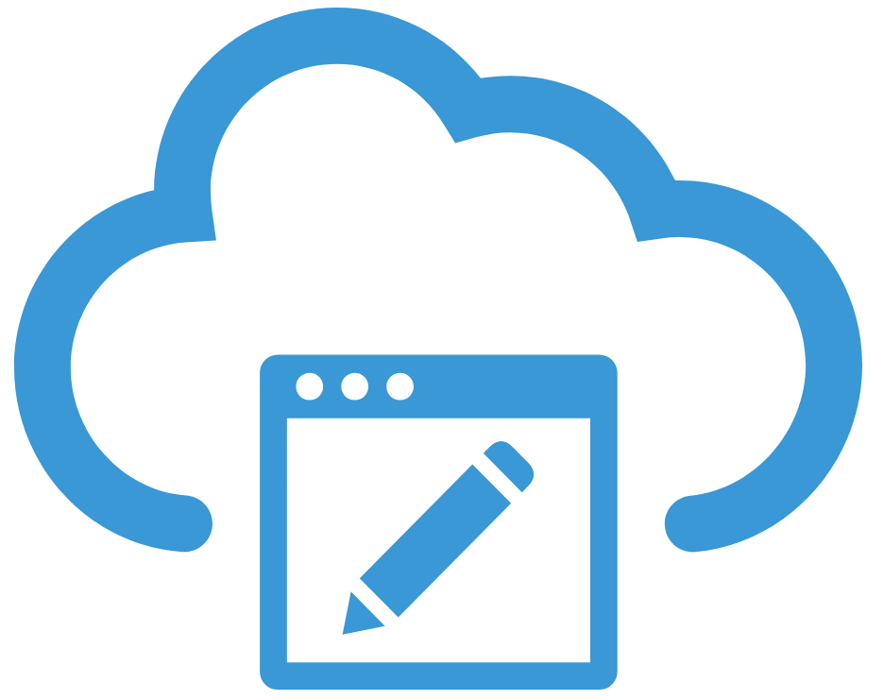
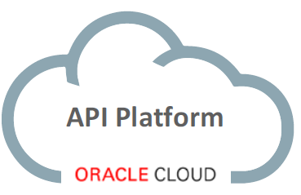




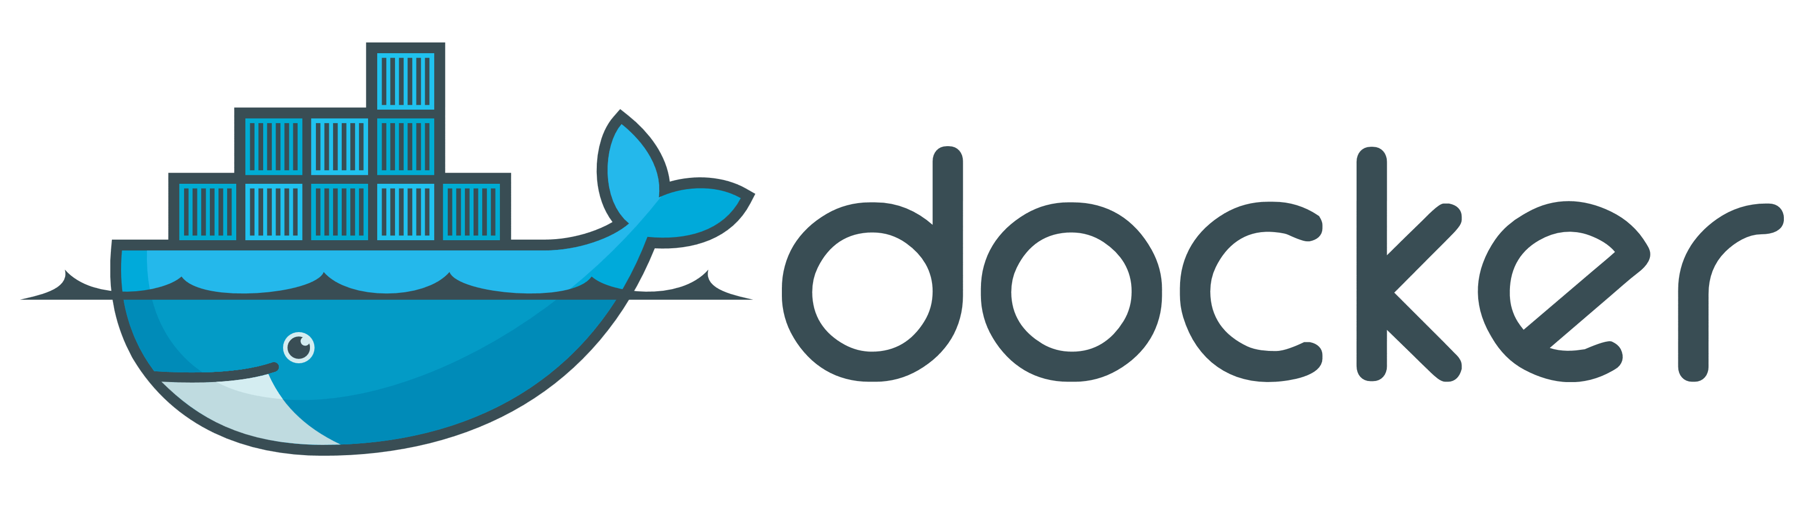


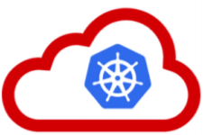


Logistics Microservice
API Platform
Apiary
API
API
Cache
Shipping Rules
Shipping Data Store
Stock Data Store
Shippings
Parcels
Log
Stock
Shipping Rules
Product Details

Slide 5



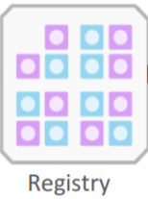


Implementation Logistics Microservice per 14/2
API Platform
Apiary
API
Wercker Container CI/CD
GitHub
Wercker Container Registry
Shipping Data Store
Shippings
Parcels
Log

Slide 6
Logistics Microservice – Data Stores
Product Stock Log
ProductIdentifier
Timestamp
QuantityChange
Category (order pick, damage, lost, replenish,…)
Location (which warehouse, which location)
Notes
Shipping Rules
ProductCategory
Country
MaximumQuantity
Shipping Data Store
Stock Data Store
Stock
Shipping Rules
Shippings
Parcels
Log
Product Details
Countries
TwoLetterIsoCode
DisplayName
Geolocation
Product Details
ProductIdentifier
Name
Weight
Dimensions
Categories (e.g. food, clothes, X-rated content, explicit lyrics, seeds, ..)
Shippings
OrderIdentifier
Destination
Status
ShippingCosts
Parcels
Location
ETA
ParcelAuditLog
ParcelLogItem
Timestamp, STatus
Items
ProductIdentifier
Quantity
AuditTrail

Slide 7
Logistics Microservice Testing/Demo Harness
Test
Test
Shipping News event for submitted shipping
Product Out Of or In Stock events
Engine
Engine
Generate calls to Submit Shipping
Generate calls to Checkout Stock & Replenish Stock
Engine
API
API
Generate & Publish * Product Updates (incl new products) * Order cancellation
Country Shipping Rules
Shipping
Parcel
Stock Item
Items
ShipLog
Stock Item Log
Mock
Engine
Test
Receive Parcel
Generate & Send Parcel updates for submitted parcels (in quick time)
Shipping News events for derived from parcel updates
Shipping Partners
(DHL, FedEx, UPS,…)

Slide 8
Routing Slip based Choreography
Shop
Order
Validate proposed order (synchronously) with Customer | Logistics | …
Initiate PlaceOrder Workflow – create routing slip instance and publish it on workflow topic
1
Meta-data: routing slip definitions per workflow
Instance data: routing slip instances with state for workflow instance
Publish Routing Slip event – with type, identifier & routing details
Choreographer
2
7
Event Topic – either for all routing slip events or for all events for a specific workflow
Choreographer User Interface
Monitoring & managing workflow instances
Managing routing slip definitions
Claim task & Retrieve Routing Slip & Workflow Instance state
4
Consume event and check if a task is ready for execution that this MS can handle
6
Submit “task status” & updates to instance state
Consume event and check if a task is ready for execution that this MS can handle
3
8
8
Customers
Order
Logistics (Warehouse, Stock, Shipping)
Billing, Invoicing & Collection
Loyalty Program
5
Perform the step in the workflow

Slide 9
The User Interfaces
Menu & Nav
Marketing content
Web (& App?) Shop – Customer User Interface
Sign Up
Sign In
Edit Profile
Sign up for loyalty program
Check on loyalty status / points
Browse/ Search Products
Inspect Details
Rate / Review
Get recommendations
Shopping basket
Inspect the bill
Place Order
Check Order Status /History
Check payment status
Inspect invoices & billing statement
Manage product details
Set prices & discounts
Manage Customers
Manage Loyalty Status
Payment Collection
Invoice mgt
Back Office User Interface
Manage Orders
Management Dashboard
New Orders (size, destination, ..)
Popular products
Order (shipping) Status
Payment status
Manage Stock
Manage Shipping

Slide 10
Events and Producers
Shop visit
Abandoned basket
Failed search
Product Withdrawn
Product Added
Product Details Changed
Shop
Product Catalog
including
Pricing & Discounts
Event Bus
Order Payment Received
Customer Frozen
Customer Unfrozen
Topic X
Topic Y
Topic Z
Topic Q
New Customer
Customer Changed
Billing, Invoicing & Collection
Customers
Customer Loyalty Status Change
New Order
Order Cancelled
Product Out Stock
Product In Stock
Order Shipping Status
Loyalty Program
Order
Logistics (Warehouse, Stock, Shipping)

Slide 11
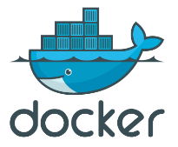





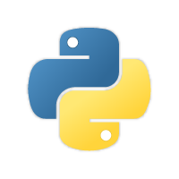
Building the build container
apk: curl, zip, nodejs, nodejs-npm
pip: Oracle PSM
npm: Oracle JET cli
apk: bash, git, openssh
build-app.sh
Docker Image
python:3.6.2-alpine3.6
Oracle Cloud psm
Oracle JET cli
build-app.sh
Notes:
https://medium.com/oracledevs/quick-start-docker-ized-paas-service-manager-cli-f54eaf4ebcc7

Slide 12
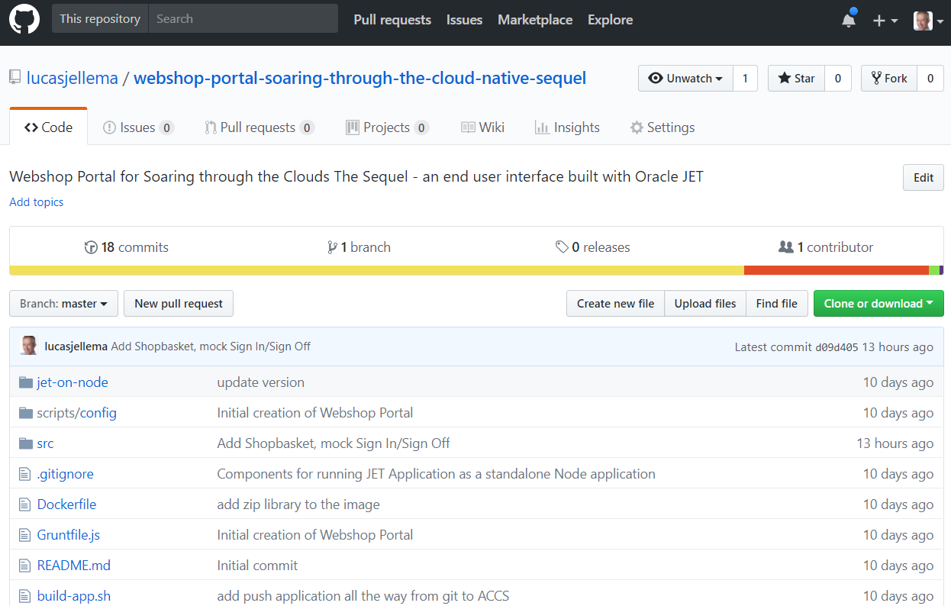



Building and Deploying the application from within the build container
Clone GitHub repo for Oracle JET application
npm install of all modules for JET app
1
GitHub
2
WebShop Portal sources
Application Sources plus node modules
Fully Built JET Web Application
ojet build for release
3
Oracle JET cli
Notes:
https://medium.com/oracledevs/quick-start-docker-ized-paas-service-manager-cli-f54eaf4ebcc7

Slide 13
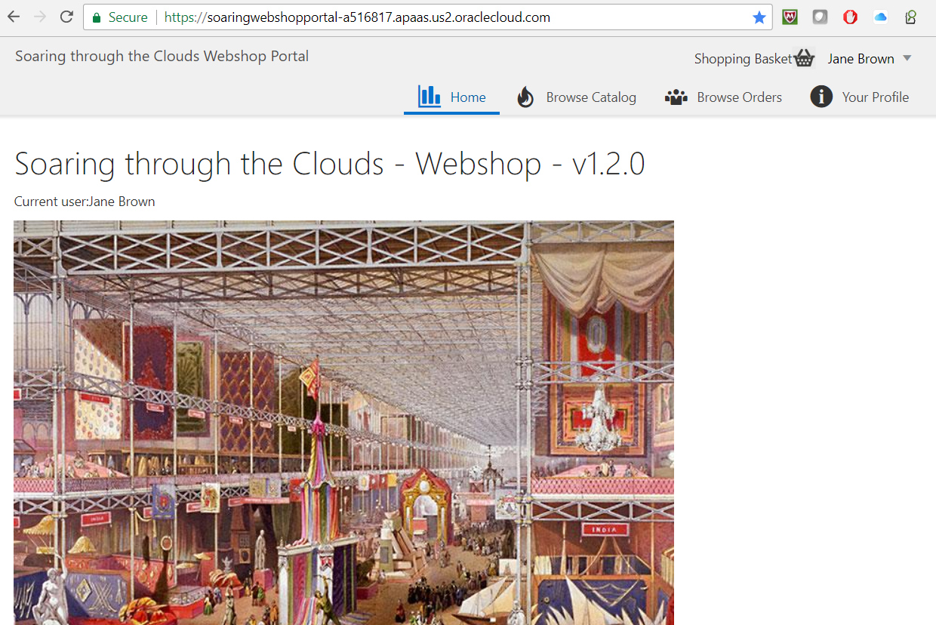

Application Container
Access the JET web application
WebShop Portal
8
Deploy zip-file with manifest.json to ACC with psm
7
Oracle Cloud psm
webshop.zip
Create final artefact by zipping the build result
6
Fully Built JET Web Application
Merged Node server side plus JET Web app
Copy build result into Node JS app
4
npm install of all node modules for Node app
5
Notes:
https://medium.com/oracledevs/quick-start-docker-ized-paas-service-manager-cli-f54eaf4ebcc7

Slide 14
Building and Deploying the application from within the build container
Application Container
Access the JET web application
Clone GitHub repo for Oracle JET application
WebShop Portal
npm install of all modules for JET app
8
1
GitHub
2
Deploy zip-file with manifest.json to ACC with psm
7
Oracle Cloud psm
webshop.zip
Create final artefact by zipping the build result
WebShop Portal sources
6
Application Sources plus node modules
Fully Built JET Web Application
Merged Node server side plus JET Web app
ojet build for release
3
Oracle JET cli
Copy build result into Node JS app
4
npm install of all node modules for Node app
5
Notes:
https://medium.com/oracledevs/quick-start-docker-ized-paas-service-manager-cli-f54eaf4ebcc7

Slide 15
Building and Deploying the application from within the build container
Access the JET web application
Application Container
WebShop Portal
GitHub
Code commit
Build, Package, Deploy
Notes:
https://medium.com/oracledevs/quick-start-docker-ized-paas-service-manager-cli-f54eaf4ebcc7

Slide 16

